Slide 1

Northrop Grumman:
Prototype 2
Presented By: Isaiah Padilla, Brandon Knutson, Daniel Cooke, Mason Goodman, Mica Nellis, Russel Stringham

Slide 2
Physical Prototype Two
Questions to be Answered:
Confirm bearing surfaces?
Verify pulley and gear system?
Gear ratios are correct?
Implementing a new style of code for the teams robotic arm drill?
Answers:
Bearing surfaces worked just as we wanted them to, our gear and pulley system worked well we need to make slight modifications with the addition of another pulley seen in final CAD. As of now gear ratios worked as needed. The new style of code being used through Marlin posed many issues in the overall production and power output in being able to move this robotic arm.
Iterations:
Refine code
Addition of pulley

Slide 3
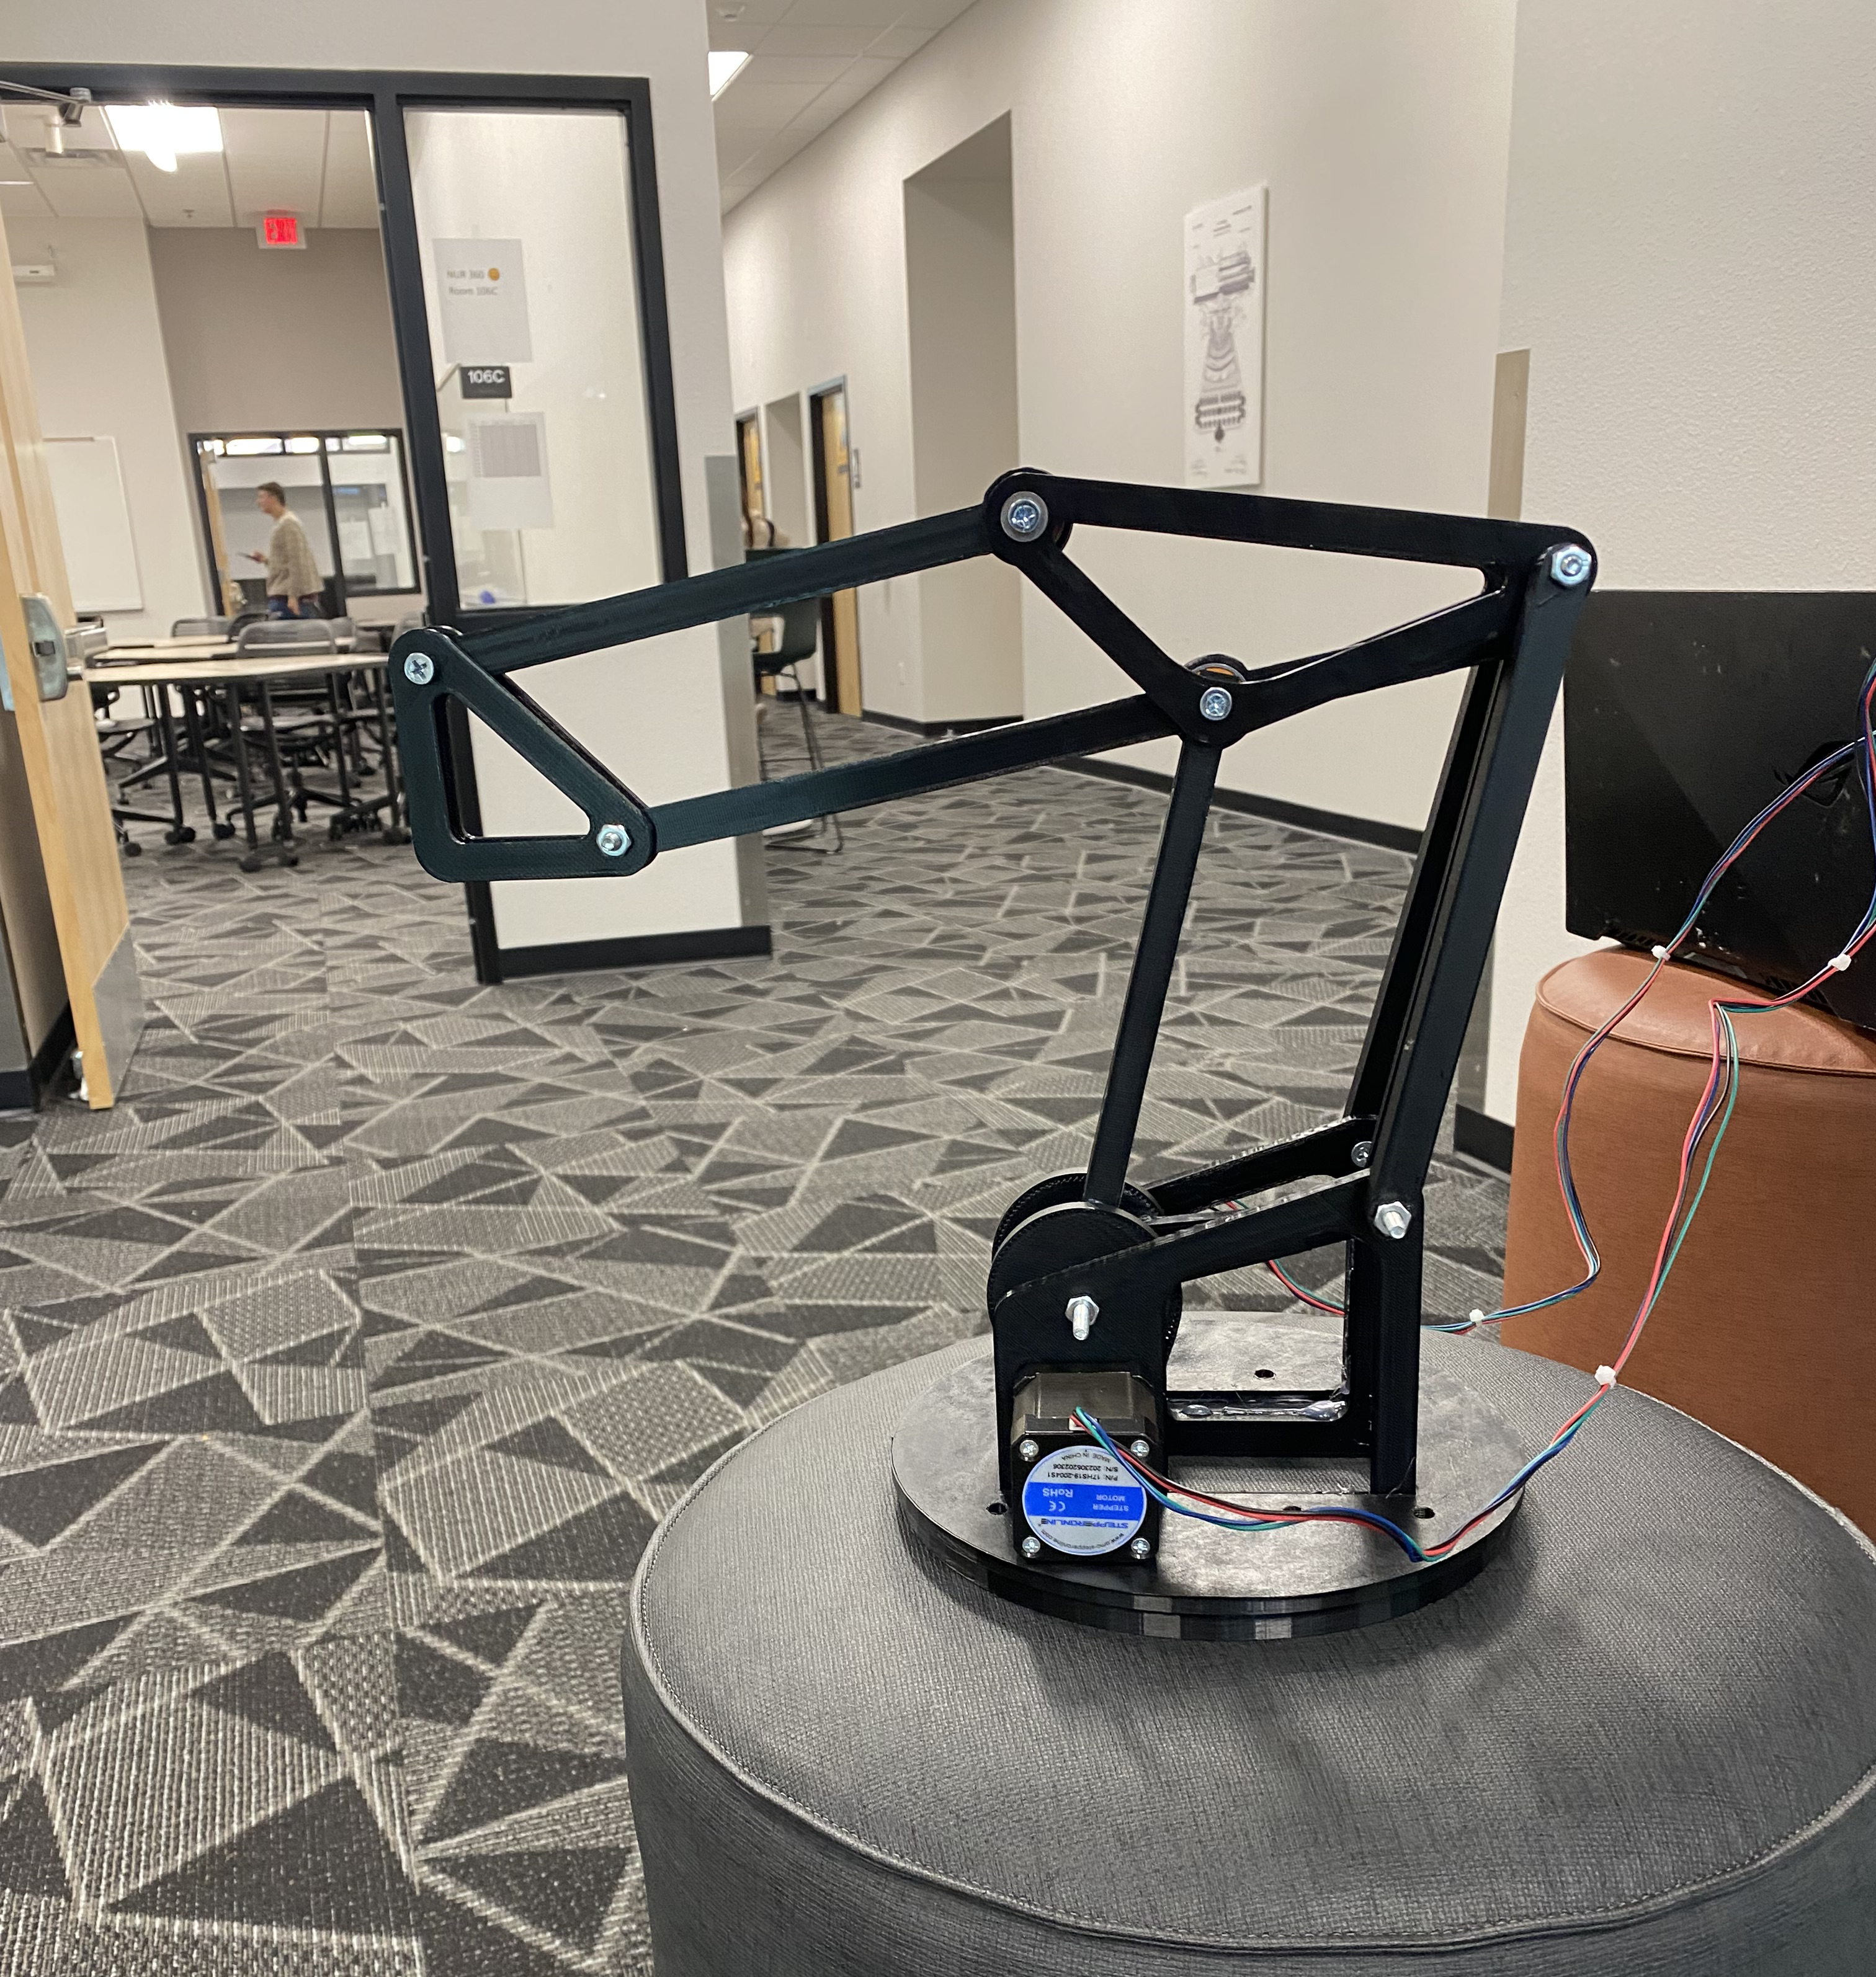
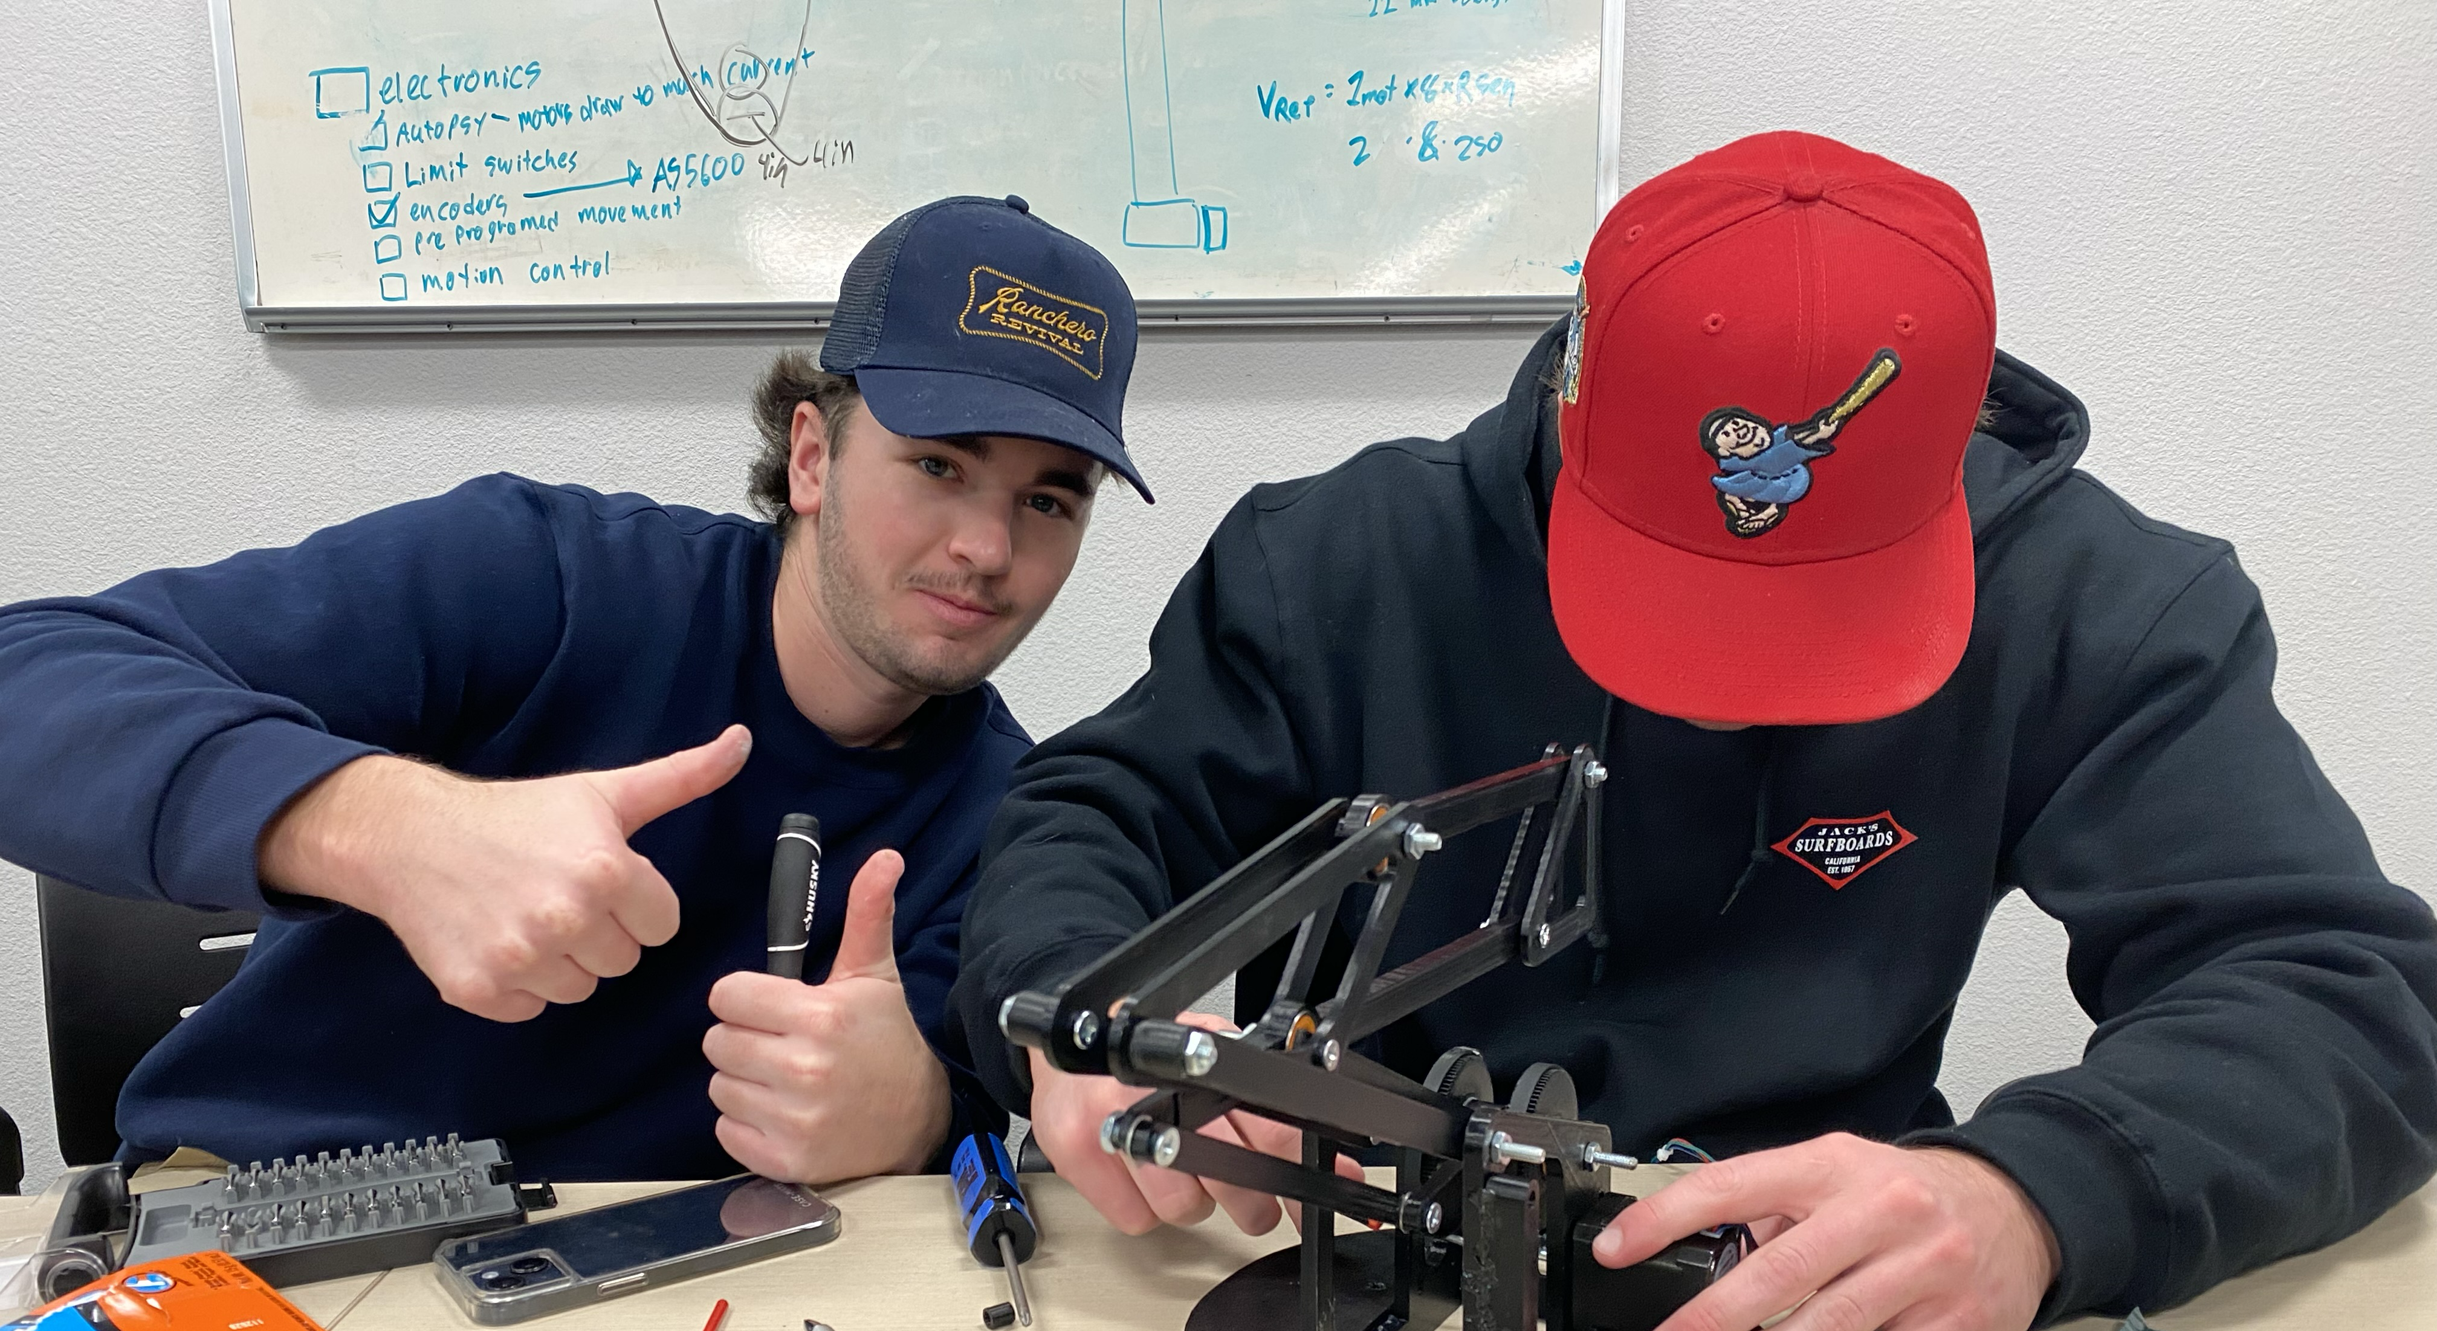
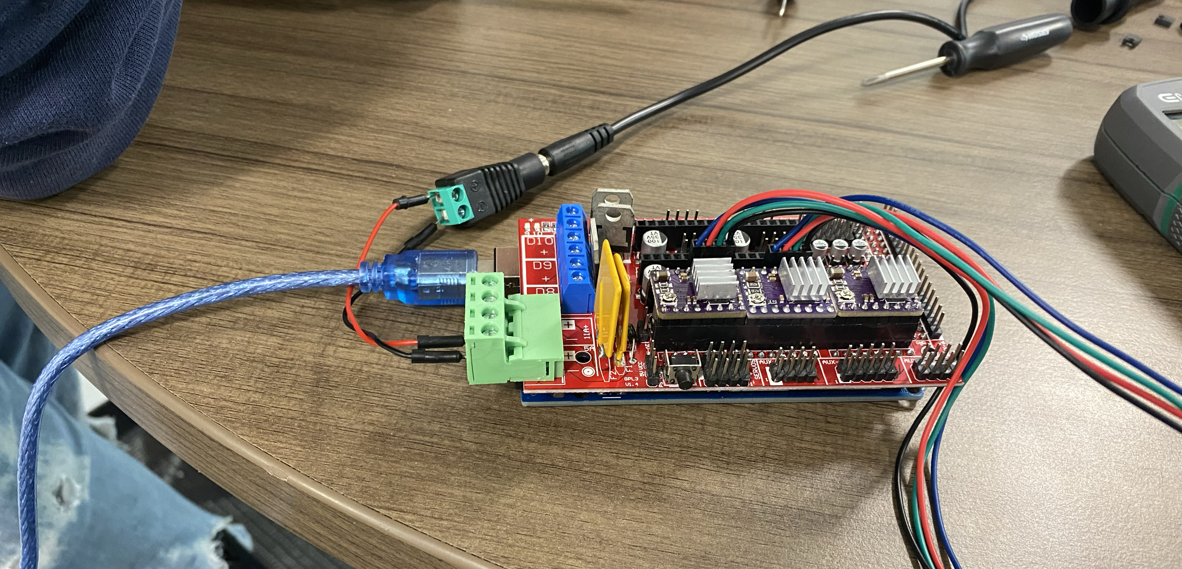

Slide 4
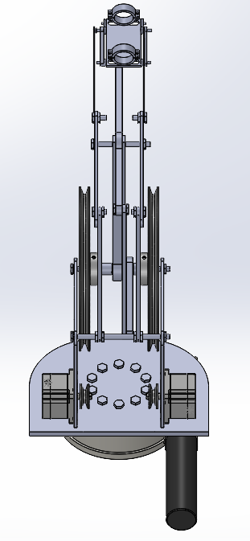
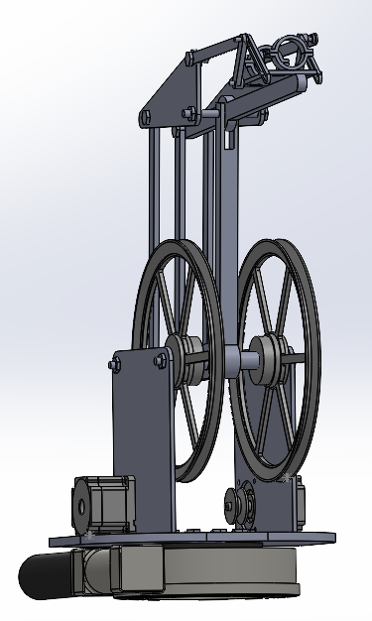
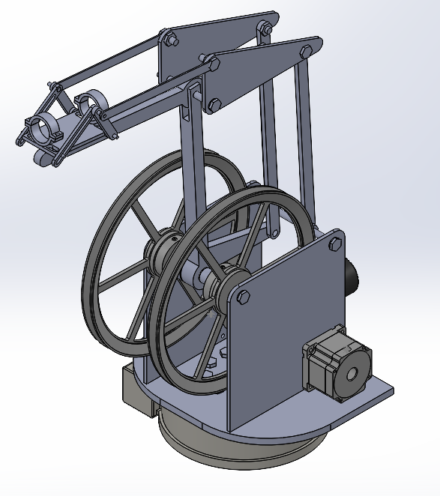
Final CAD

Slide 5
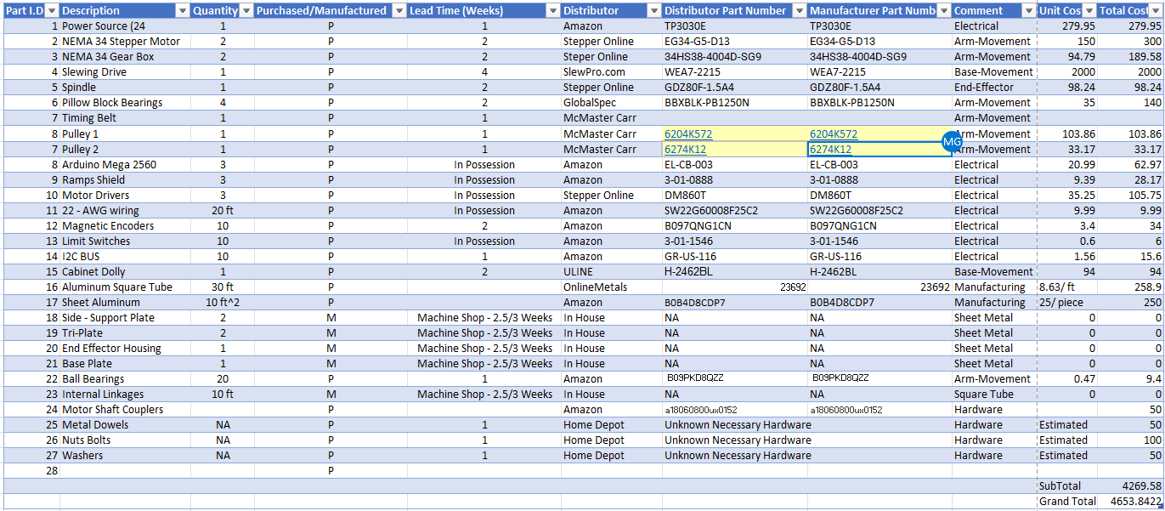
Final Bill of Materials

Slide 6
Thank You

Slide 7
